Slide 1


TRAFFIC PREDICTION.
TEAM SciPy.

Slide 2
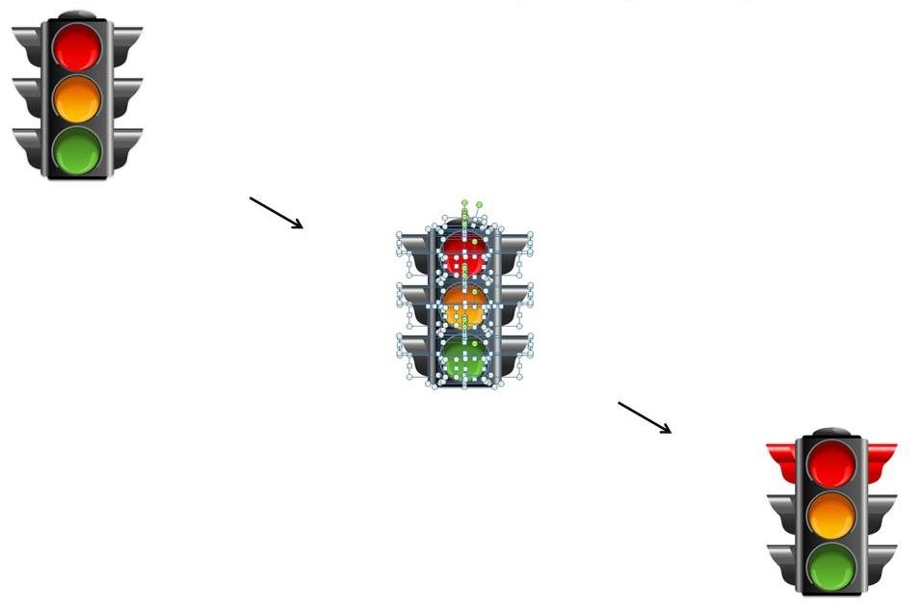



PRESENTERS
OTHER ACTIVE MEMBERS
LEADS
Chisom Promise - Team Lead
Pearse Jim - Ass.Team Lead
Victoria Udoh - Query Analyst
Gozie Ibekwe | Babatunde Raji
Pragati Thakur | Zainab Mohammed
Fidel Imasuen | Djardo Isaac Kweku
Oguamanam Chinyere P. | Bernard Boateng
Subair Hussein K | Samuel Nnamani
Lakshay Arora | Bissalla Daniel
Zainab Mohammed | Emekobong Udoh
Odion Sonny-Egbeahie | Omotayo Waheed
Kevin Outta
Joshua
Obikunle
Bertram Okonkwo

Slide 3
OUTLINE
Introduction
Problem Statement
Aim of Project
Data Gathering
Data Preparation (Cleaning, EDA)
Traffic Prediction Model
Power BI Dashboard
Conclusion

Slide 4
INTRODUCTION
Traffic congestion is rising in cities around the world. Contributing factors include expanding urban populations, aging infrastructure, inefficient and uncoordinated traffic signal timing, and a lack of real-time data. Given the physical and financial limitations around building additional roads, cities must use new strategies and technologies to improve traffic conditions.
In this project, we will analyze the provided Traffic dataset on Kaggle. The provided dataset includes hourly traffic data on four different junctions in a particular city.

Slide 5

PROBLEM STATEMENT
Traffic congestion is rising in cities around the world. Contributing factors include
expanding urban populations,
aging infrastructure,
inefficient and uncoordinated traffic signal timing, and
a lack of real-time data.

Slide 6
AIM OF PROJECT
The aim of this project is to derive insights from this analysis and then build a model/models that can be used to predict traffic at particular times at the different junctions in the city.

Slide 7
Data GATHERING
In this project, we will analyze the provided Traffic dataset on Kaggle. The provided dataset includes hourly traffic data on four different junctions in a particular city.

Slide 8
DATA Preparation
Dataset was cleaned by
Converting the ‘Date’ column to Datatime and Extracting different time frames
Exploratory Data Analysis (EDA).
Plotting Heatmap To Visualize The Correlation of Input to the Target.
From The Correlation Heatmap Plotted below "Junction 1" had the highest correlation to the number of Vehicles while the day of year and Month had the lowest correlation to the target.

Slide 9
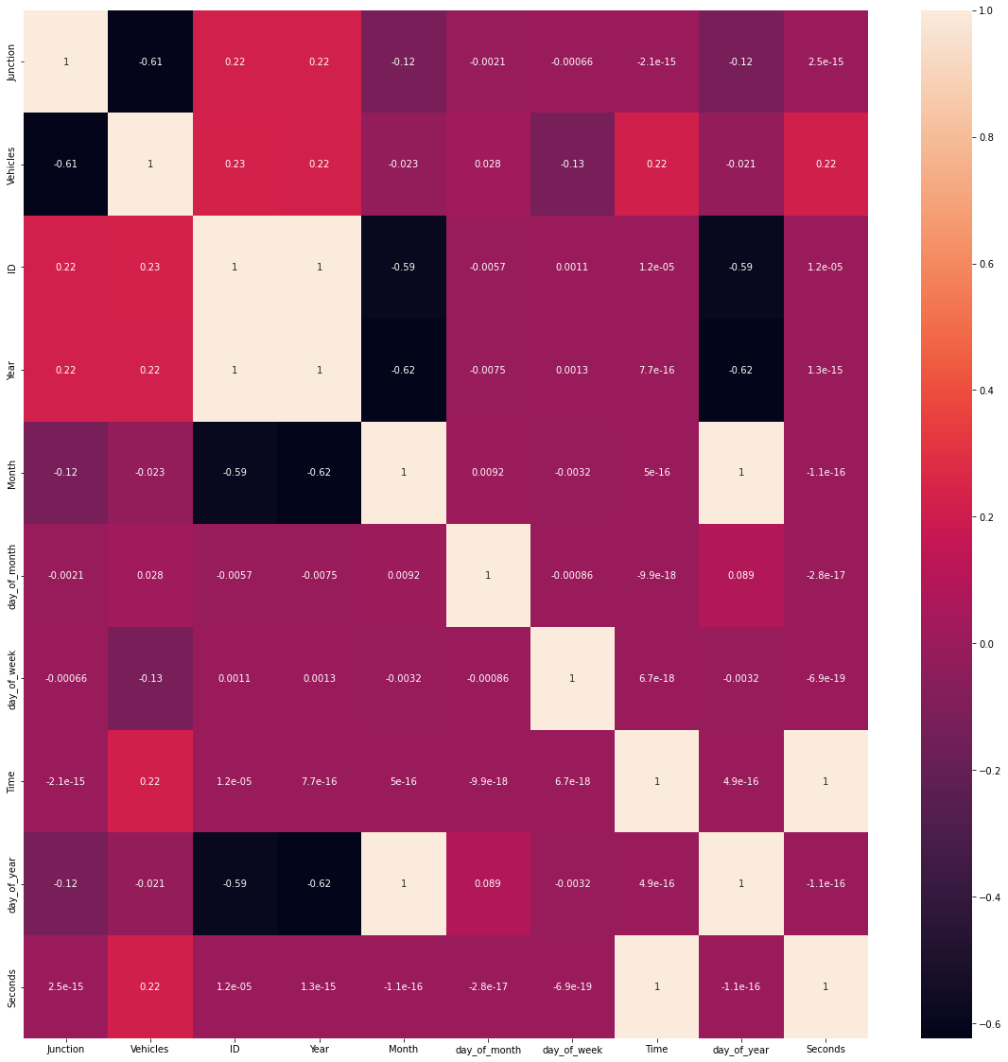
Exploratory Data Analysis (EDA).

Slide 10
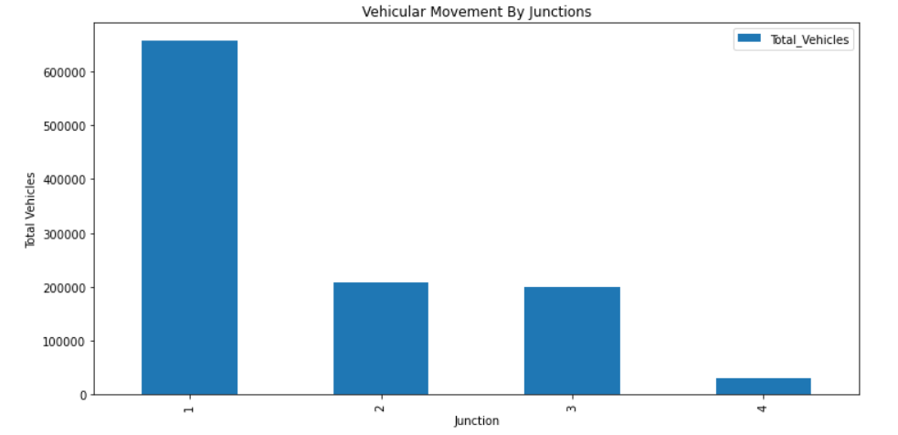
Exploratory Data Analysis (EDA).
Extracting and Visualizing Total Vehicular Movement for each Junction.
From the Bar plot above, Junction 1 has the highest cumulative vehicular movement over the date under consideration. Junction 4 on the other hand, had very little vehicle movement compared to others because it came at a later date in the period under consideration.

Slide 11
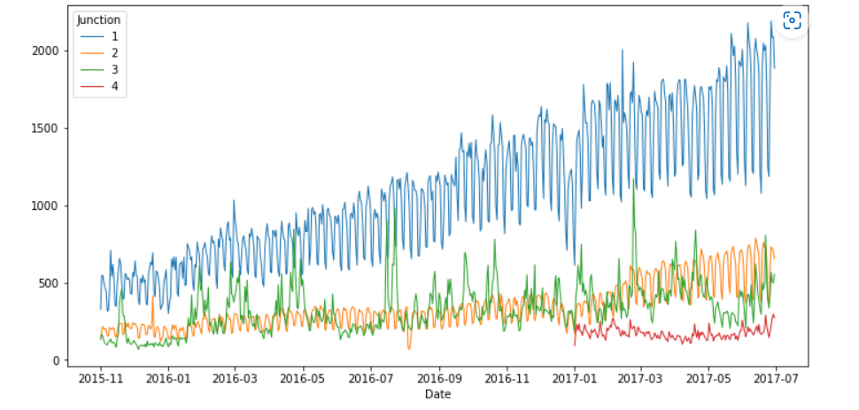
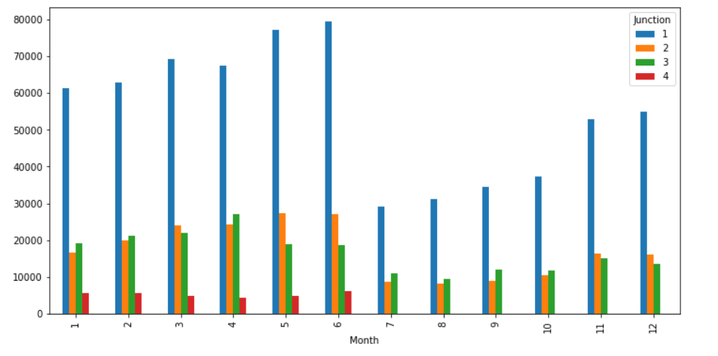
Using a time series chart (Line Chart) to visualize vehicular movement volume for each junction for the duration under review
The Visualization showed a comparative analysis of cumulative traffic movement over the month of the period in review for the junctions. With the exception of Junction 4 which had a recording for just the first half of the year, there seems to be a rising case of traffic across all junctions where the traffic dropped and start rising again.
Using a time series chart (Line Chart) to visualize vehicular movement volume for each junction for the duration under review

Slide 12
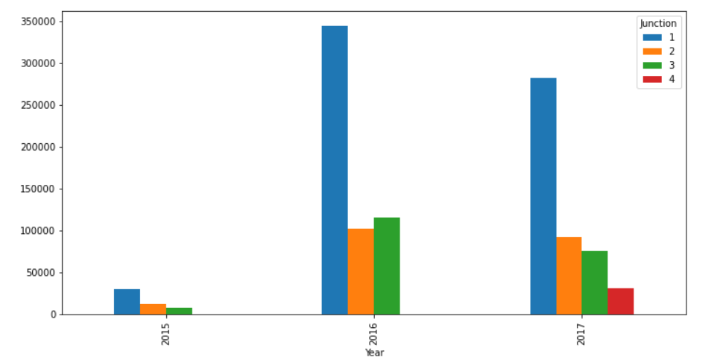
Using a bar plot to compare the rate of vehicular movement with A year for each junction
The Year Bar Plot showed a sharp increase in Traffic Movement for Junction 1 through 3 for 2016 as compared to 2015 which dropped for 2017 with the addition of junction 4

Slide 13
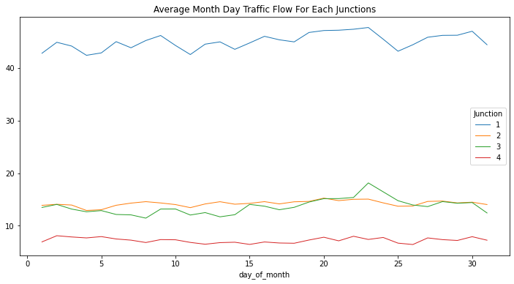
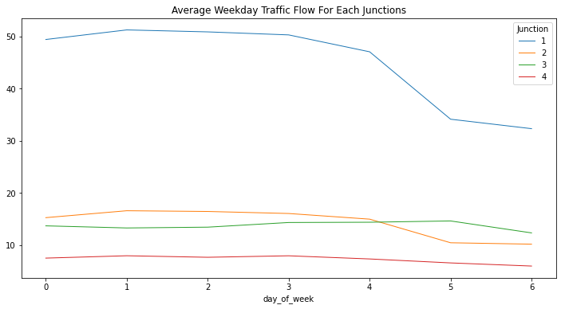
Visualizing the AVERAGE Daily Traffic situation for each junction AND Day of The Week Traffic Analysis and Visualization
The Average MonthDaily Traffic Visualization Portrayed a Steady flow until the end of the month where there is a sharp drop for all junctions
Average traffic flow was observed to be steady across all junctions until the Fourth day (Thursday) where there is a sharp drop in movement till the rest of the week

Slide 14
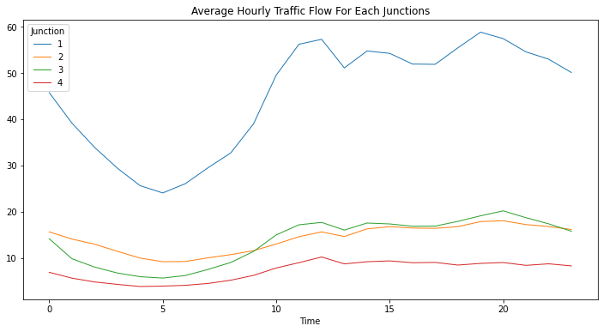
Visualizing Hourly Vehicular Movement for each Junction
The Hourly Analysis Shows the Least Traffic situation in the early period of the day, with peak traffic experienced at the later hour of the day

Slide 15
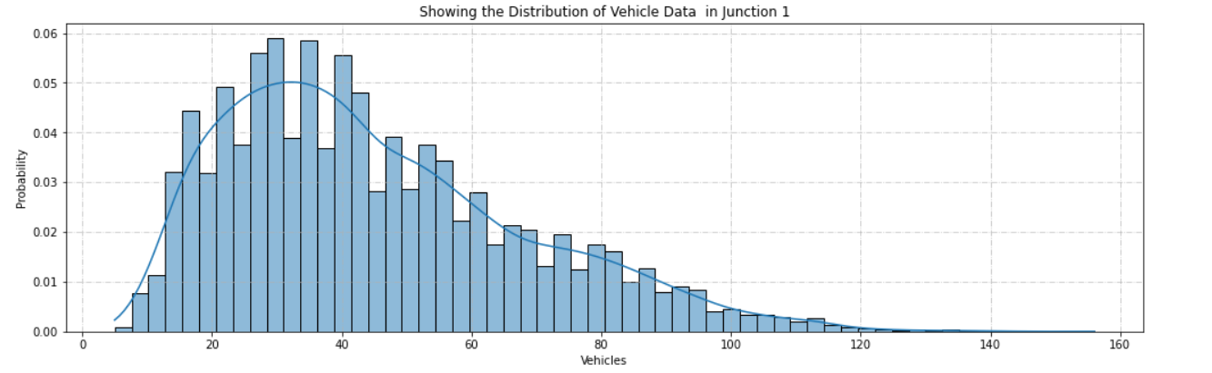
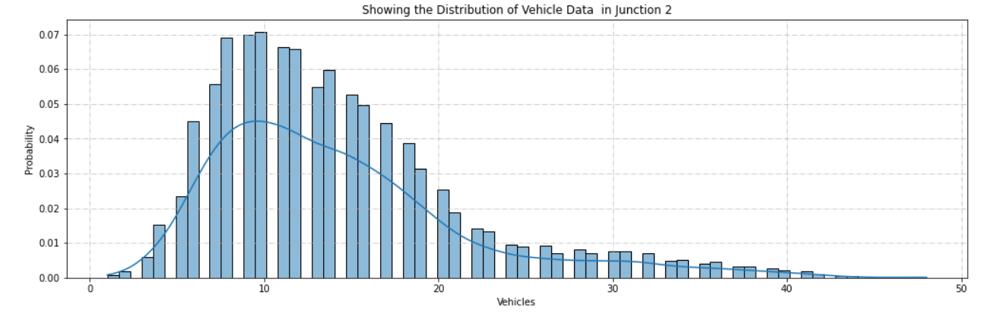
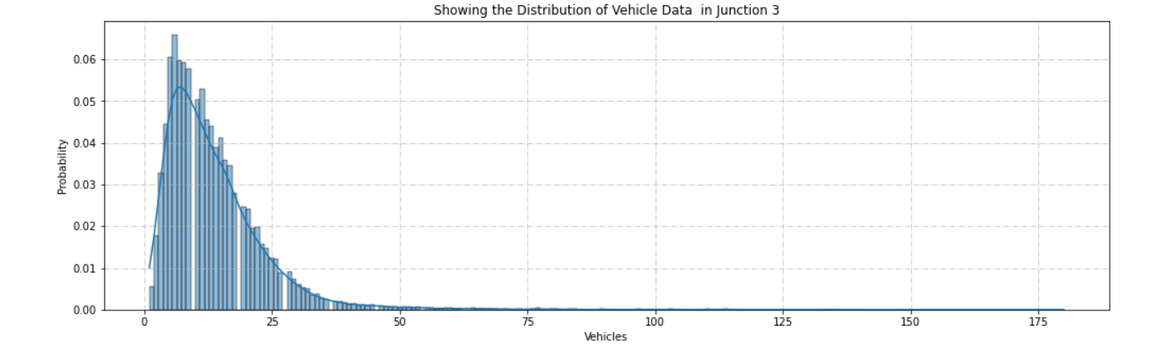
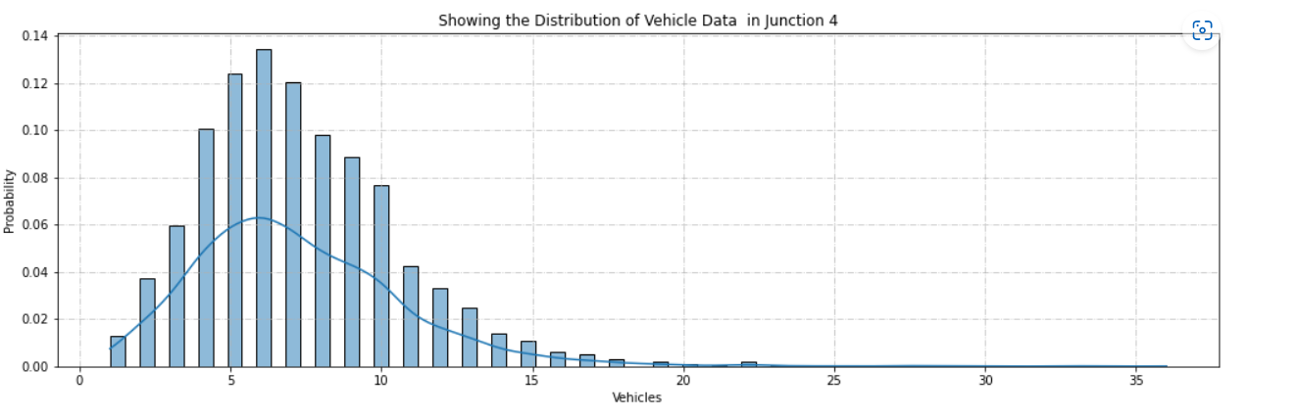
Bivariate Analysis On Junctions

Slide 16
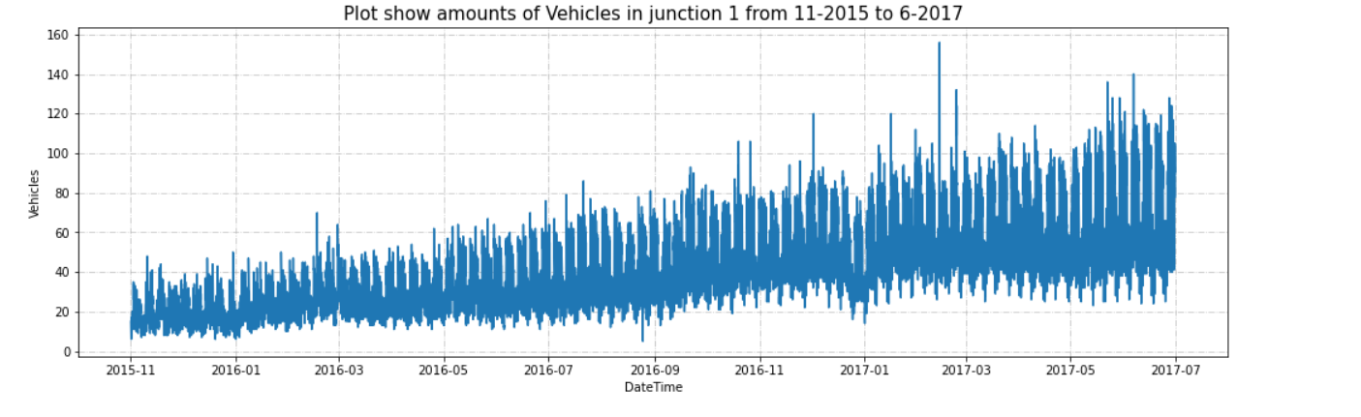
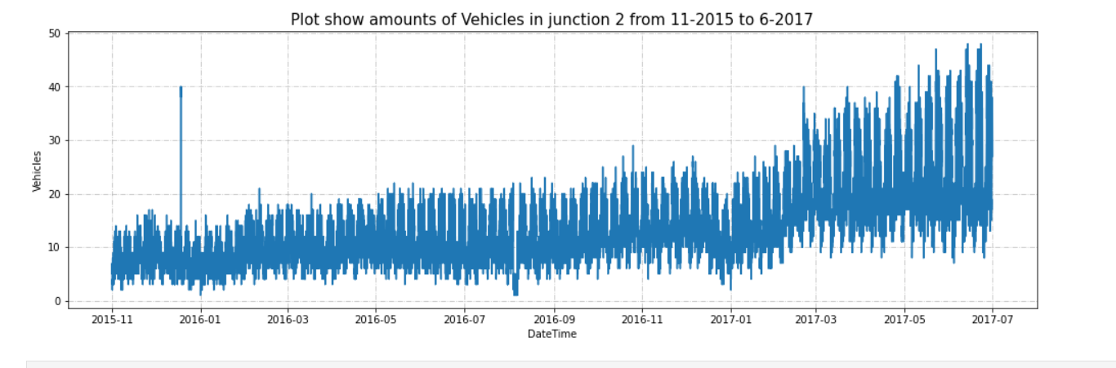
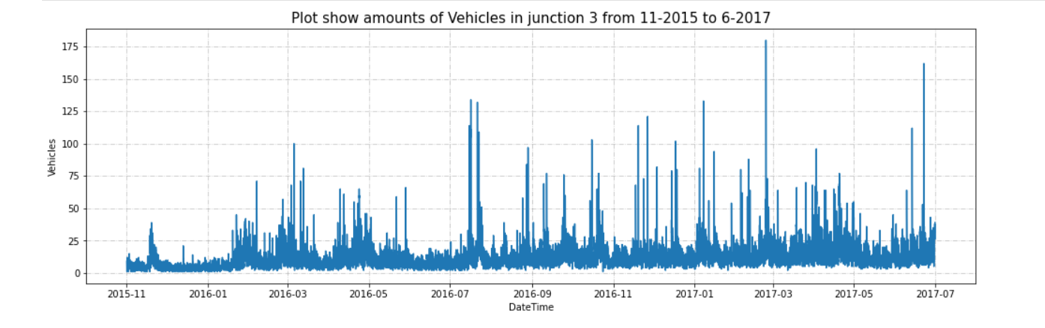
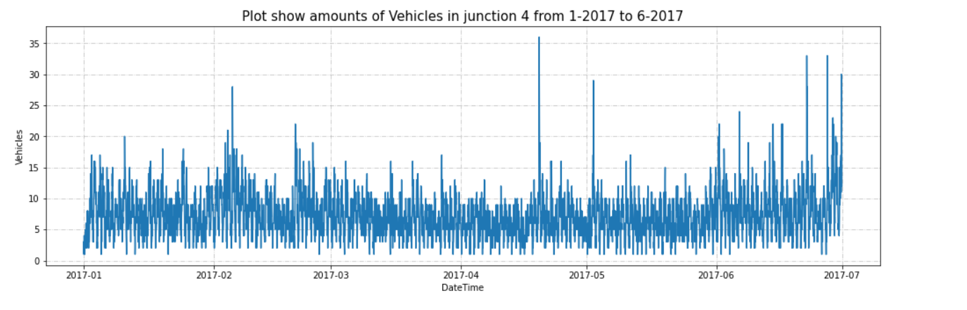
AMOUNT OF VEHICLE DATA IN EACH JUNCTION

Slide 17
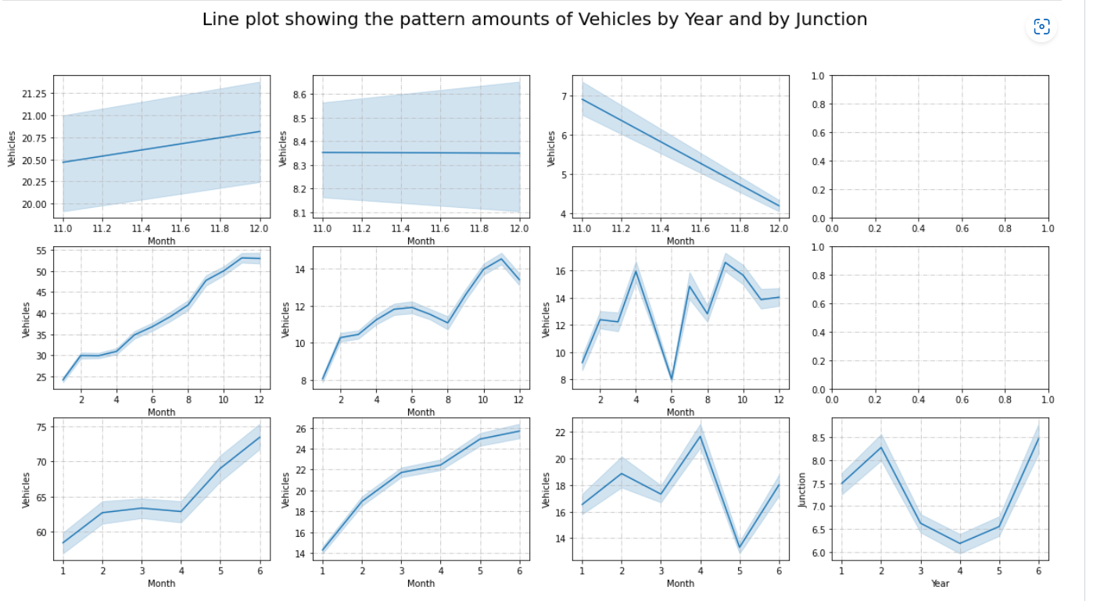
LINE PLOT SHOWING THE PATTERN AMOUNTS OF VEHICLES BY YEAR AND BY JUNCTION
Yearly, there has been an upward trend for all junctions except for the fourth junction. As we already established above that the fourth junction has limited data that don't span over a year.
We can see that there is an influx in the first and second junctions around June. I presume this may be due to summer break and activities around the same.
Monthly, throughout all the dates there is a good consistency in data.
For a day, we can see that are peaks during morning and evening times and a decline during night hours. This is as per expectation.
For weekly patterns, Sundays enjoy smoother traffic as there are lesser vehicles on roads. Whereas Monday to Friday the traffic is steady.

Slide 18
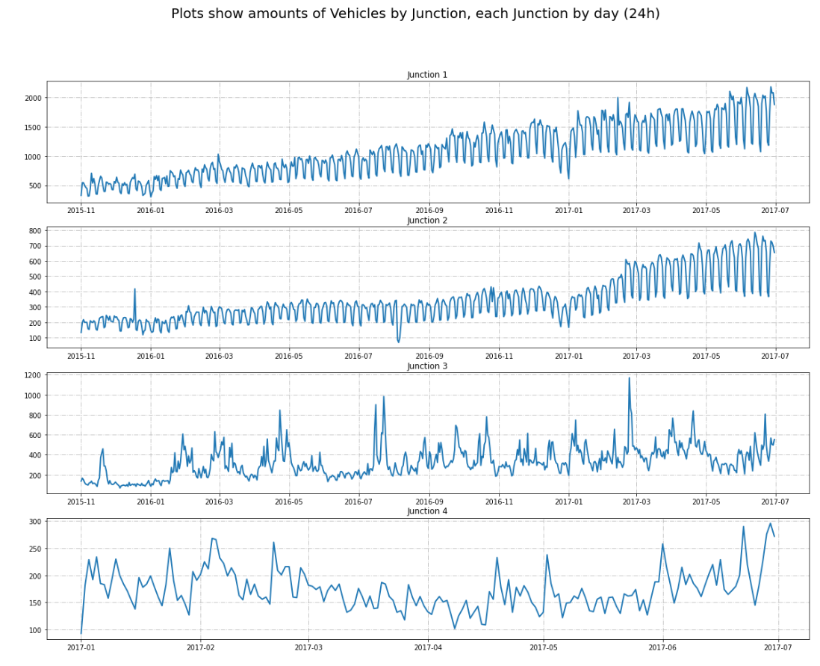
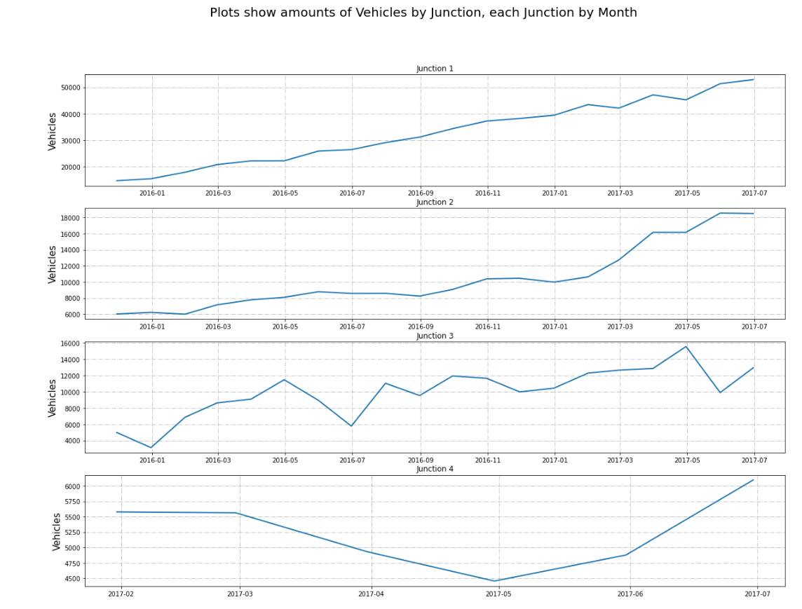
PLOTS SHOW AMOUNT OF VEHICLES BY JUNCTION, EACH JUNCTION BY DAY (24H)

Slide 19
COMMENT ON THE ABOVE DATA ANALYSIS
There has been an upward trend of vehicles yearly in all four junctions with junction 1 having the highest upward trend
We notice an increase in the first and third junctions around the month of June, this might be due to summer activities that happen around that time.
We notice a daily increase in Vehicular movement in all the junctions except junction four which started recording data in January 2017.
With the exception of junction 4, We notice the data increasing during the morning time, around 6 am, staying steady throughout the afternoon, and decreasing during the evening time around 8 pm.
We also notice that we have less traffic during the weekend and steady traffic during the weekdays.
Junction 4 was created to reduce the overall traffic situation on the axis which seemed to work.

Slide 20
TRAFFIC PREDICTION MODEL
Creating New Features by Target Encoding Some Features and Extracting from DateTime.
First, new features like Day of the week, Day of Month, Quarter, Month, and Time were extracted from the DateTime column, and then target Encoding was used to create new features with aggregates: Std, Max, Min, Mean and Median.
Seperating the dataset based on junctions.
We created 4 datasets from the original dataset, one for each junction, and then dropped the ID and Junction column. This is done because we are building 4 models, one for each junction. Based on our dataset, the data for each hour was provided for all the junctions hence we had more than one observation for one particular time.

Slide 21
TRAFFIC PREDICTION MODEL CONT.
Building Baseline Models for each junction to check their performance and choose the best-performing one
A Baseline Model was built and the Root Mean Square Error(RMSE) and Mean Absolute Percentage Error (MAPE) were used as evaluation metrics to choose the best-performing models. The lower the value of the RMSE and MAPE, the better performing the model was. For Junction 2,3 and 4, the best-performing baseline model was LGBM
For Junction 1, the best-performing baseline model was RandomForest, followed closely by LGBM, but ultimately we chose LGBM for a particular reason which is after model evaluation and tuning, the LGBM model performed better.

Slide 22
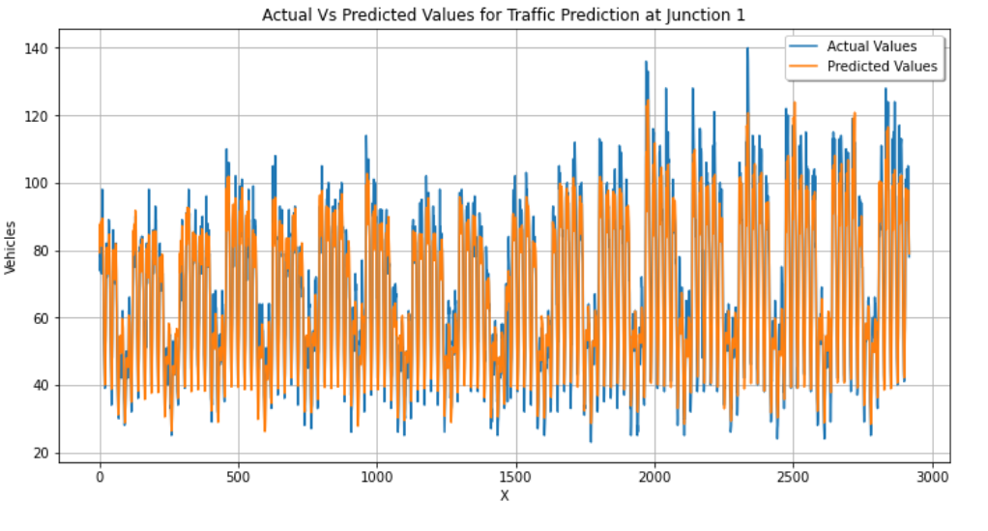
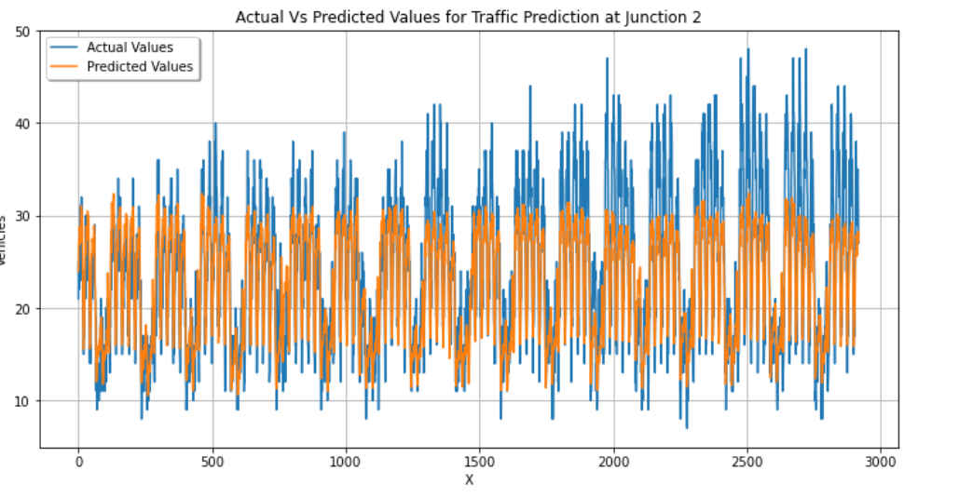
TRAFFIC PREDICTION MODEL CONT.

Slide 23
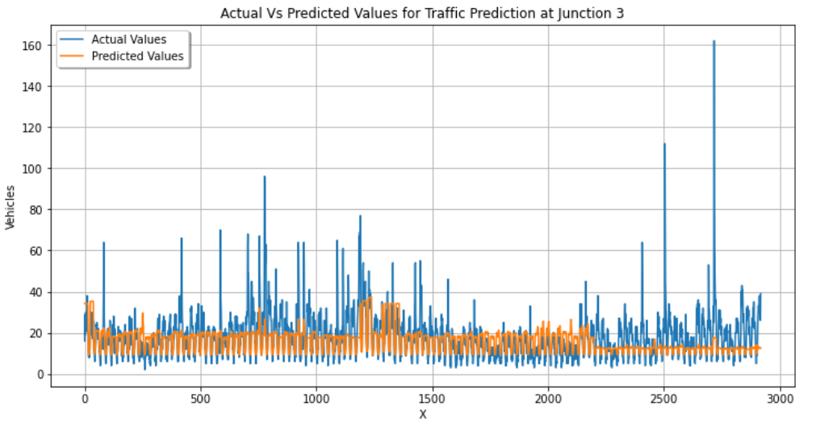
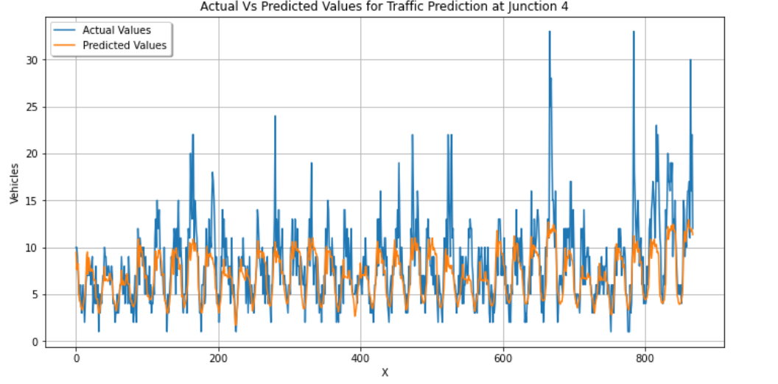
TRAFFIC PREDICTION MODEL CONT.

Slide 24
TRAFFIC PREDICTION MODEL CONT.
Checking for Overfitting with TimeSeries Cross Validation and Choosing the Best Model
None of the models was overfitting after we tested with TimeSeries cross-validation.
Checking Feature Importance to get rid of unimportant Features
The importance of all the features was checked to see which ones added noise to our models and we noticed the features with no importance to the models and dropped them.

Slide 25
Model deployment
Here’s the link to the deployed model.
This model is used to predict the number of vehicles that will be at a particular junction at a particular date and at a particular point in time.

Slide 26
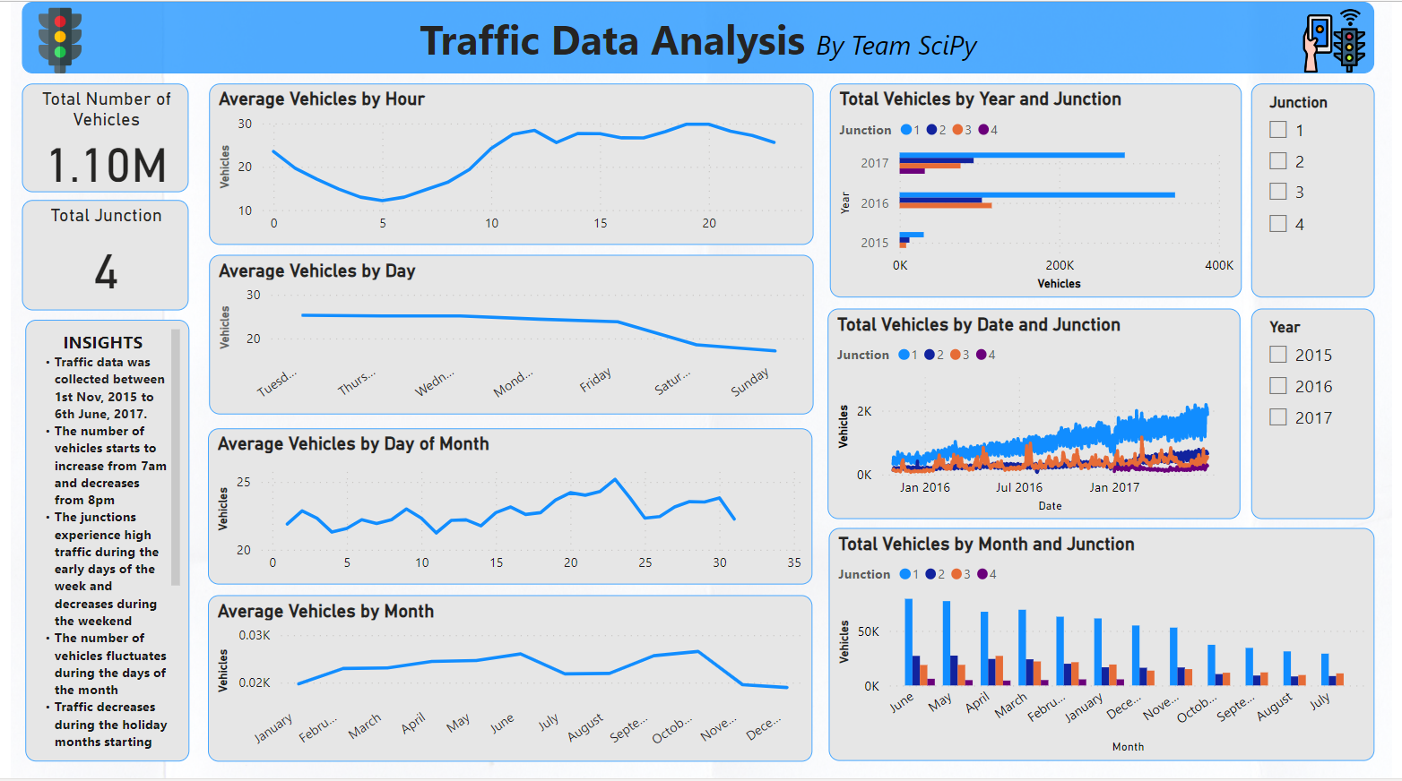
POWER BI DASHBOARD
Here's a link to the dashboard report that we created at the end of this project. In these reports, we tried to visualize the insights derived from the analysis of the traffic data like which junction had the most vehicular movement at a particular time of the day, month and year.

Slide 27
CONCLUSION
There has been an upward trend of vehicles yearly in all four junctions with junction 1 having the highest upward trend
We notice an increase in the first and third junctions around the month of June, this might be due to summer activities that happen around that time.
We notice a daily increase in Vehicular movement in all the junctions except junction four which started recording data in January 2017.
With the exception of junction 4, We notice the data increasing during the morning time, around 6 am, staying steady throughout the afternoon, and decreasing during the evening time around 8 pm.
We also notice that we have less traffic during the weekend and steady traffic during the weekdays.
Junction 4 was created to reduce the overall traffic situation on the axis which seemed to work.

Slide 28
THANK YOU !!!
SciPy

